Slide 1




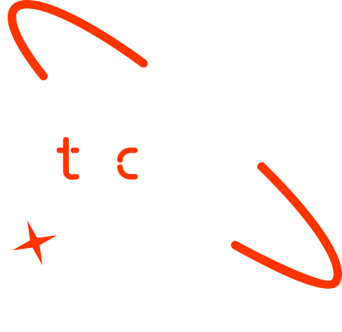

Effective Solar Panel Detection & Recognition for Global Sustainability
Yoseph Matalo
David Mukajanga
Arya Ghimire
Mainza Chiyobeka
28 September 2024

Slide 2

Outline
Concept note and implementation plan
Background
Objectives
SDG Relation
Data
Data Collection
Exploratory Data Analysis et Feature Engineering
Model
Model Selection and Training
Model Evaluation and Hyperparameter Tuning
Model Refinement and Testing
Results
Evaluation Results
Deployment
Future Work

Slide 3
Concept note and Implementation Plan
Notes:
FTs like precision agriculture, remote sensing & AI-powered forming equipment can help increase agricultural productivity in LDCs. This can improve fiid security & contribute to the achievement of SDG 2 (Zero Hunger).

Slide 4
Background
Brief Project Overview:
The project focuses on developing a machine learning model for detecting solar panels from satellite and aerial imagery.
The model is intended to aid in monitoring and managing solar energy infrastructure by automating the detection process.
Notes:
FTs like precision agriculture, remote sensing & AI-powered forming equipment can help increase agricultural productivity in LDCs. This can improve fiid security & contribute to the achievement of SDG 2 (Zero Hunger).

Slide 5
Background
As renewable energy sources gain importance, the deployment and maintenance of solar panels are crucial.
Manual detection of solar panels is time-consuming and prone to errors; thus, automating this process using machine learning is key.
Notes:
FTs like precision agriculture, remote sensing & AI-powered forming equipment can help increase agricultural productivity in LDCs. This can improve fiid security & contribute to the achievement of SDG 2 (Zero Hunger).

Slide 6
Background
Importance of the Problem Being Solved:
Accurate solar panel detection is essential for energy management, policy-making, and ensuring proper infrastructure maintenance.
This project also contributes to the global shift towards sustainable energy solutions by improving solar energy monitoring.
Notes:
FTs like precision agriculture, remote sensing & AI-powered forming equipment can help increase agricultural productivity in LDCs. This can improve fiid security & contribute to the achievement of SDG 2 (Zero Hunger).

Slide 7
Objectives
Building a neural network capable of identifying solar panels from satellite images with high accuracy.
Creating a platform where users can input geographic information and receive data on solar panel distribution in their area.
Leveraging available datasets from source and real-time satellite data to enhance model performance [1].
These objectives directly contribute to solving the identified problem of inconsistent and inaccurate solar panel detection due to environmental factors and data limitations [2].
Notes:
FTs like precision agriculture, remote sensing & AI-powered forming equipment can help increase agricultural productivity in LDCs. This can improve fiid security & contribute to the achievement of SDG 2 (Zero Hunger).

Slide 8
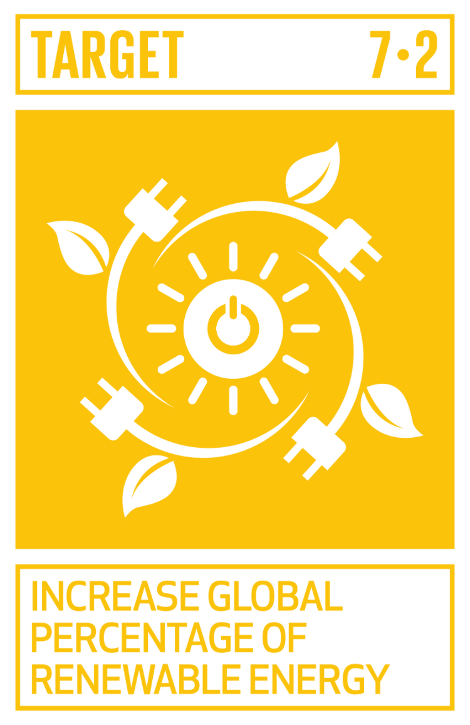

SDG Relation
Contribution to SDG 7 (Affordable and Clean Energy):The project aligns with SDG 7, which focuses on ensuring access to affordable, reliable, sustainable, and modern energy for all.
Relevance to Target 7.2:Target 7.2 emphasizes increasing the share of renewable energy in the global energy mix.By improving the detection and tracking of solar energy installations, the project contributes to increasing the visibility and adoption of solar energy [3].
Notes:
FTs like precision agriculture, remote sensing & AI-powered forming equipment can help increase agricultural productivity in LDCs. This can improve fiid security & contribute to the achievement of SDG 2 (Zero Hunger).

Slide 9
Data
Notes:
FTs like precision agriculture, remote sensing & AI-powered forming equipment can help increase agricultural productivity in LDCs. This can improve fiid security & contribute to the achievement of SDG 2 (Zero Hunger).

Slide 10
Data Collection
Source of the Dataset :
Data collected from high-resolution satellite images (Google Earth, Sentinel-2) and aerial images from drones.
Notes:
FTs like precision agriculture, remote sensing & AI-powered forming equipment can help increase agricultural productivity in LDCs. This can improve fiid security & contribute to the achievement of SDG 2 (Zero Hunger).

Slide 11
Data Collection
Preprocessing Steps During Data Collection:
Images were cleaned and preprocessed, which included resizing, cropping, and color normalization.
Metadata like geolocation and timestamps were also extracted.
Notes:
FTs like precision agriculture, remote sensing & AI-powered forming equipment can help increase agricultural productivity in LDCs. This can improve fiid security & contribute to the achievement of SDG 2 (Zero Hunger).

Slide 12
Data Collection
Handling Missing Values, Outliers :
Missing data in the metadata (like timestamps) was imputed.
Outliers in image quality (e.g., cloudy or low-resolution images) were filtered out.
Notes:
FTs like precision agriculture, remote sensing & AI-powered forming equipment can help increase agricultural productivity in LDCs. This can improve fiid security & contribute to the achievement of SDG 2 (Zero Hunger).

Slide 13
Exploratory Data Analysis and Feature Engineering
Process of Creating or Transforming Features:
Key features such as pixel intensity, texture, and shape were derived from the imagery to aid in solar panel identification.
Spatial features (e.g., geolocation) were also incorporated to identify regions with higher solar panel density.
Notes:
FTs like precision agriculture, remote sensing & AI-powered forming equipment can help increase agricultural productivity in LDCs. This can improve fiid security & contribute to the achievement of SDG 2 (Zero Hunger).

Slide 14
Exploratory Data Analysis and Feature Engineering
Rationale Behind Feature Engineering Decisions:
These features were chosen based on their ability to capture unique characteristics of solar panels (rectangular shapes, spectral signatures).
Notes:
FTs like precision agriculture, remote sensing & AI-powered forming equipment can help increase agricultural productivity in LDCs. This can improve fiid security & contribute to the achievement of SDG 2 (Zero Hunger).

Slide 15
Exploratory Data Analysis and Feature Engineering
Normalization, Encoding:
Image data was normalized to ensure consistency across varying light and resolution conditions.
One-hot encoding was applied to categorical metadata (like region or type of imagery).
Notes:
FTs like precision agriculture, remote sensing & AI-powered forming equipment can help increase agricultural productivity in LDCs. This can improve fiid security & contribute to the achievement of SDG 2 (Zero Hunger).

Slide 16
Model
Notes:
FTs like precision agriculture, remote sensing & AI-powered forming equipment can help increase agricultural productivity in LDCs. This can improve fiid security & contribute to the achievement of SDG 2 (Zero Hunger).

Slide 17
Model Selection and Training
Rationale for Choosing a Specific Model:
A Convolutional Neural Network (CNN) was selected for its superior performance in image classification tasks.
Other models like Random Forests were considered but found less effective for complex image-based tasks.
Notes:
FTs like precision agriculture, remote sensing & AI-powered forming equipment can help increase agricultural productivity in LDCs. This can improve fiid security & contribute to the achievement of SDG 2 (Zero Hunger).

Slide 18
Model Selection and Training
CNN Strengths: High accuracy, ability to detect complex patterns in images.
CNN Weaknesses: Computationally intensive, requires large amounts of data.
Notes:
FTs like precision agriculture, remote sensing & AI-powered forming equipment can help increase agricultural productivity in LDCs. This can improve fiid security & contribute to the achievement of SDG 2 (Zero Hunger).

Slide 19
Model Selection and Training
Details on Training the Model:
The model was trained using a large dataset of satellite images labeled with the presence or absence of solar panels.
Training involved several epochs with a learning rate scheduler to optimize convergence.
Notes:
FTs like precision agriculture, remote sensing & AI-powered forming equipment can help increase agricultural productivity in LDCs. This can improve fiid security & contribute to the achievement of SDG 2 (Zero Hunger).

Slide 20
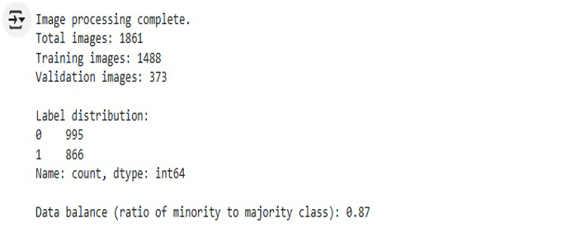
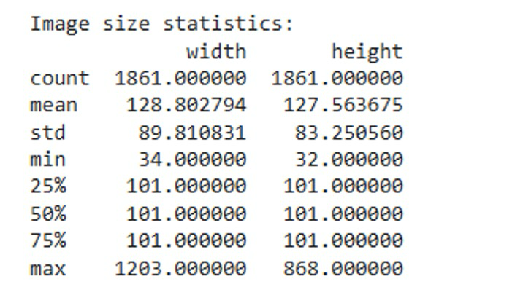
Model Selection and Training
Image Distribution
Image Size Statistics
Notes:
FTs like precision agriculture, remote sensing & AI-powered forming equipment can help increase agricultural productivity in LDCs. This can improve fiid security & contribute to the achievement of SDG 2 (Zero Hunger).

Slide 21
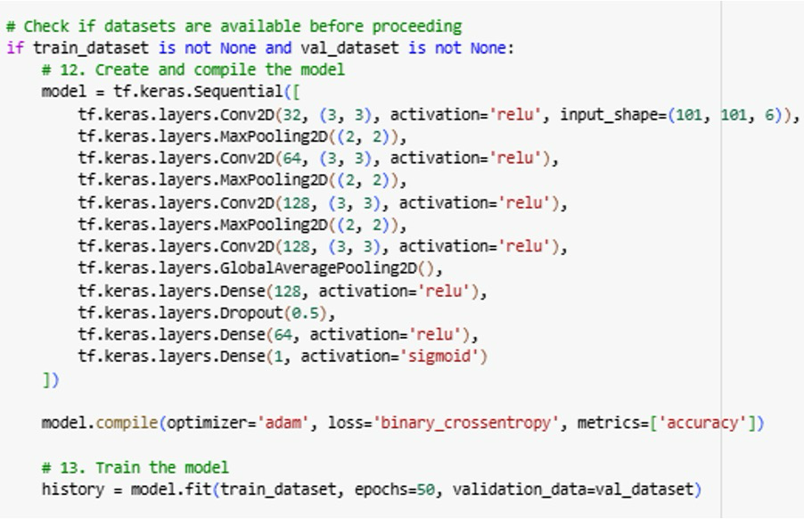
Model Selection and Training
Hyper-parameters & Cross-Validation
Notes:
FTs like precision agriculture, remote sensing & AI-powered forming equipment can help increase agricultural productivity in LDCs. This can improve fiid security & contribute to the achievement of SDG 2 (Zero Hunger).

Slide 22
Model Evaluation and Hyperparameter Tuning
Evaluation Metrics and Visualizations:
Metrics: Accuracy, Precision, Recall, and F1-Score.
Confusion matrices and ROC curves were used to visualize performance.
Notes:
FTs like precision agriculture, remote sensing & AI-powered forming equipment can help increase agricultural productivity in LDCs. This can improve fiid security & contribute to the achievement of SDG 2 (Zero Hunger).

Slide 23
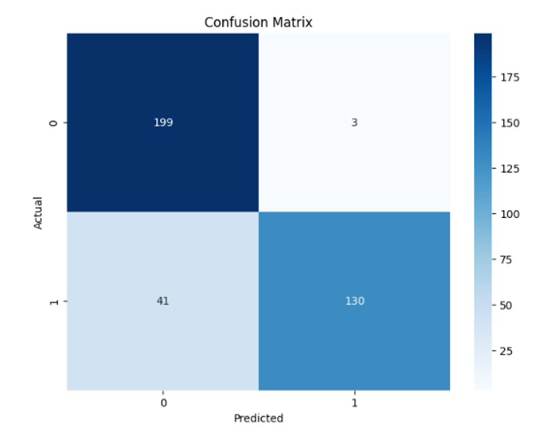
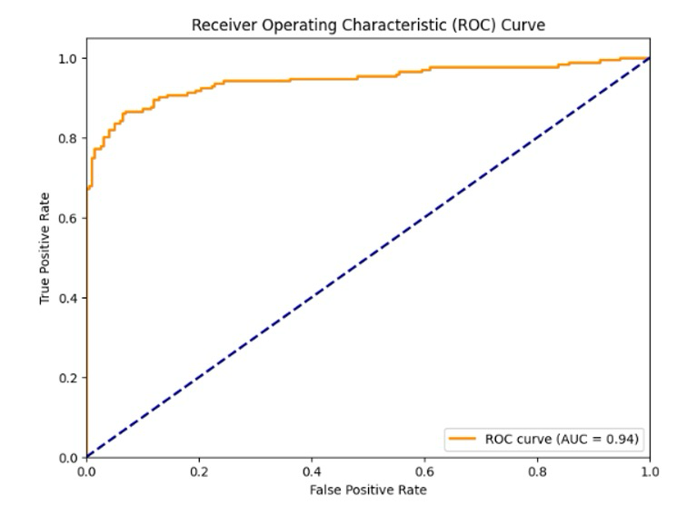
Model Evaluation and Hyperparameter Tuning
The Confusion Matrix
The ROC Curve
Notes:
FTs like precision agriculture, remote sensing & AI-powered forming equipment can help increase agricultural productivity in LDCs. This can improve fiid security & contribute to the achievement of SDG 2 (Zero Hunger).

Slide 24
Model Evaluation and Hyperparameter Tuning
Models Performance:
The CNN model achieved a high accuracy of 88% on the validation set.
Precision and Recall scores showed reliable performance in detecting solar panels.
Notes:
FTs like precision agriculture, remote sensing & AI-powered forming equipment can help increase agricultural productivity in LDCs. This can improve fiid security & contribute to the achievement of SDG 2 (Zero Hunger).

Slide 25
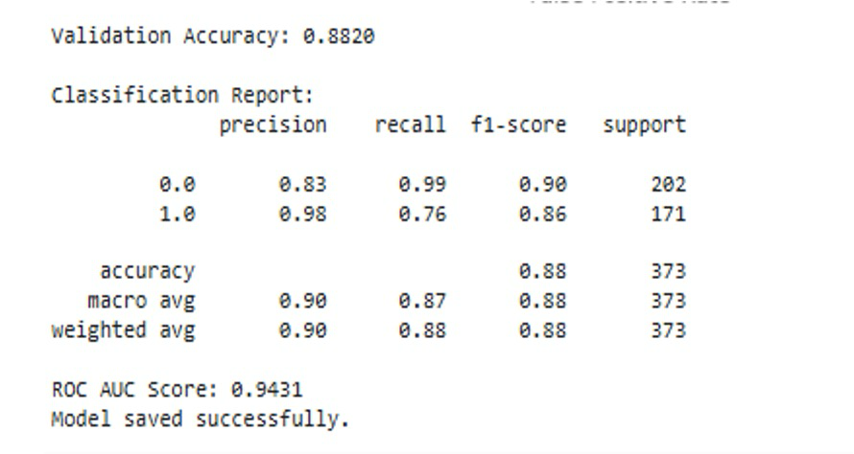
Model Selection & Training
Convolutional Neural Network
Notes:
FTs like precision agriculture, remote sensing & AI-powered forming equipment can help increase agricultural productivity in LDCs. This can improve fiid security & contribute to the achievement of SDG 2 (Zero Hunger).

Slide 26
Model Refinement and Testing
Overview of the Refinement Phase:
Adjustments were made to the model’s architecture by adding more convolutional layers to improve detection and accuracy.
Notes:
FTs like precision agriculture, remote sensing & AI-powered forming equipment can help increase agricultural productivity in LDCs. This can improve fiid security & contribute to the achievement of SDG 2 (Zero Hunger).

Slide 27
Model Refinement and Testing
Techniques Used for Model Improvement:
Data augmentation (rotations, flips) was applied to improve the model’s robustness to variations in the imagery.
Notes:
FTs like precision agriculture, remote sensing & AI-powered forming equipment can help increase agricultural productivity in LDCs. This can improve fiid security & contribute to the achievement of SDG 2 (Zero Hunger).

Slide 28
Model Refinement and Testing
Overview of the Test Submission Phase:
The final model was tested on unseen data, achieving a 88% accuracy rate on the test dataset.
Notes:
FTs like precision agriculture, remote sensing & AI-powered forming equipment can help increase agricultural productivity in LDCs. This can improve fiid security & contribute to the achievement of SDG 2 (Zero Hunger).

Slide 29
Model Refinement and Testing
Metrics and Results on the Test Dataset:
F1-Score of 0.90 and AUC (Area Under the Curve) of 0.93, showing the model’s strong performance across all test data.
Notes:
FTs like precision agriculture, remote sensing & AI-powered forming equipment can help increase agricultural productivity in LDCs. This can improve fiid security & contribute to the achievement of SDG 2 (Zero Hunger).

Slide 30
Results
Notes:
FTs like precision agriculture, remote sensing & AI-powered forming equipment can help increase agricultural productivity in LDCs. This can improve fiid security & contribute to the achievement of SDG 2 (Zero Hunger).

Slide 31
Evaluation Results
Results of our Project:
The model successfully detected solar panels with an accuracy of over 88%, showing high reliability in real-world scenarios.
The deployment of this model can greatly assist in the automation of solar energy infrastructure monitoring.
Notes:
FTs like precision agriculture, remote sensing & AI-powered forming equipment can help increase agricultural productivity in LDCs. This can improve fiid security & contribute to the achievement of SDG 2 (Zero Hunger).

Slide 32
Deployment
Overview:
The trained model was serialized using TensorFlow and deployed via a Flask API.
Integration with the Google Maps API allowed users to input locations and receive predictions in real-time.
Notes:
FTs like precision agriculture, remote sensing & AI-powered forming equipment can help increase agricultural productivity in LDCs. This can improve fiid security & contribute to the achievement of SDG 2 (Zero Hunger).

Slide 33
Deployment
Model Serialization, Serving, and API Integration:
The model was stored in the .keras format for efficient loading.
A REST API was created using Flask to handle image input and output predictions.
Notes:
FTs like precision agriculture, remote sensing & AI-powered forming equipment can help increase agricultural productivity in LDCs. This can improve fiid security & contribute to the achievement of SDG 2 (Zero Hunger).

Slide 34
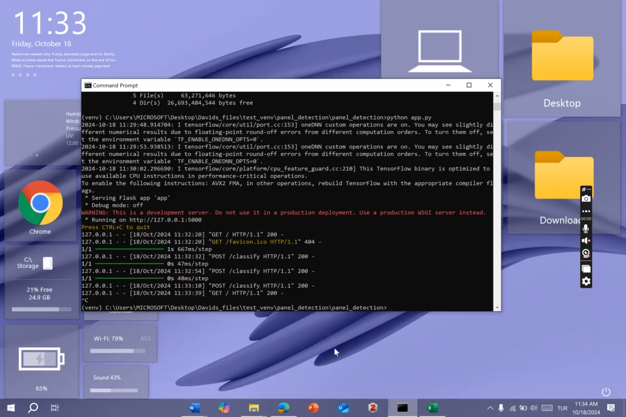
Deployment
Notes:
FTs like precision agriculture, remote sensing & AI-powered forming equipment can help increase agricultural productivity in LDCs. This can improve fiid security & contribute to the achievement of SDG 2 (Zero Hunger).

Slide 35
Future Work
Areas for Future Improvement and Expansion:
Improve model accuracy by incorporating more diverse datasets, including images under different lighting and weather conditions.
Expand the model to detect solar panel defects using thermal imagery.
Notes:
FTs like precision agriculture, remote sensing & AI-powered forming equipment can help increase agricultural productivity in LDCs. This can improve fiid security & contribute to the achievement of SDG 2 (Zero Hunger).

Slide 36
Future Work
Additional Features, Models, or Data Sources for Exploration:
Explore multi-modal models that integrate thermal and satellite images for more comprehensive monitoring.
Additional features could include real-time monitoring with drone-based image collection systems.
Notes:
FTs like precision agriculture, remote sensing & AI-powered forming equipment can help increase agricultural productivity in LDCs. This can improve fiid security & contribute to the achievement of SDG 2 (Zero Hunger).

Slide 37
References
1. Komar, M., Yakobchuk, P., Golovko, V., Dorosh, V., & Sachenko, A. (2018). Deep Neural Network for Image Recognition Based on the Caffe Framework. In 2018 IEEE Second International Conference on Data Stream Mining & Processing (DSMP), Lviv, Ukraine, 102-106. https://doi.org/10.1109/DSMP.2018.8478621
2. Phiri, M., Mulenga, M., Zimba, A., & Eke, C. I. (2023). Deep learning techniques for solar tracking systems: A systematic literature review, research challenges, and open research directions. Solar Energy, 262, 111803. https://doi.org/10.1016/j.solener.2023.111803
3. Golovko, V., Kroshchanka, A., Mikhno, E., & Komar, M. (2021). Deep Convolutional Neural Network for Detection of Solar Panels. In Radivilova, T., Ageyev, D., Kryvinska, N. (eds) Data-Centric Business and Applications. Lecture Notes on Data Engineering and Communications Technologies, vol 48. Springer, Cham. https://doi.org/10.1007/978-3-030-43070-2_17
Notes:
FTs like precision agriculture, remote sensing & AI-powered forming equipment can help increase agricultural productivity in LDCs. This can improve fiid security & contribute to the achievement of SDG 2 (Zero Hunger).

Slide 38

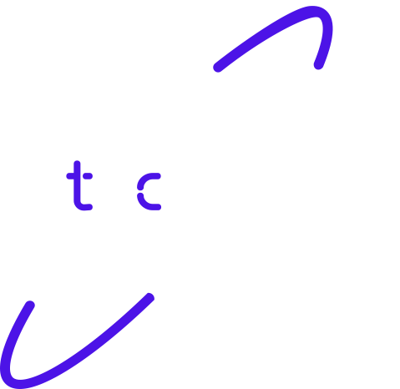
Thank you!

